Slide 1
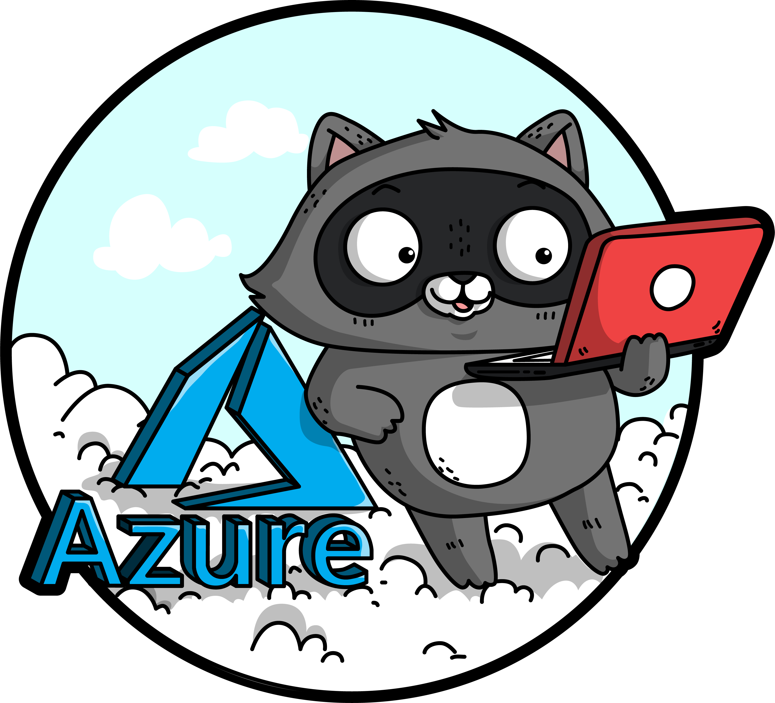
Avoiding the Wild West!
Sarah Lean

Slide 2

Photo by Martijn Baudoin on Unsplash

Slide 3

Sarah Lean
Cloud Solution Architect
Blogger | Curler | Photographer | Book Lover | Runner | Speaker | STEM Ambassador
13+ years experience in IT
@TechieLass
https://www.techielass.com

Slide 5


What to expect from this session
Azure Cost Management (ACM)
Azure Policy
Azure Blueprints
Azure Automation

Slide 6



Slide 7


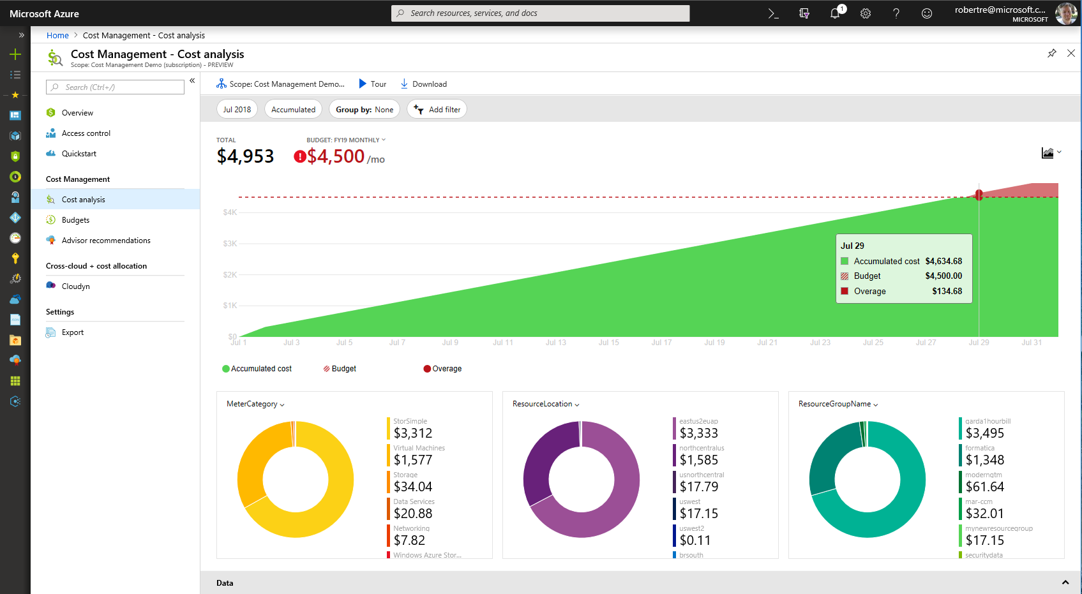
Azure Cost Management
Built into Azure
NEW
On by default
Better experience for more users
Richer analysis and budget alerting
Integrated with Azure Advisor
Reduced data latency by up to 80%
Free to manage Azure costs

Slide 8
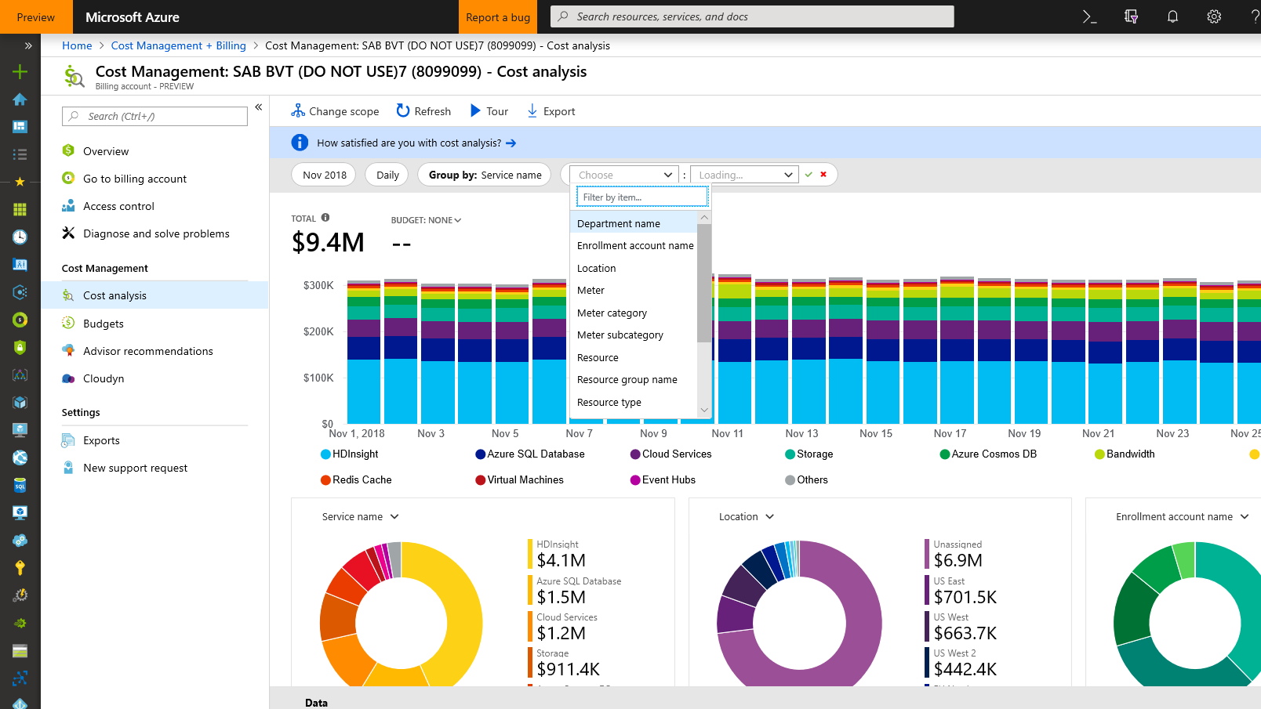
Monitor cloud spend
Track usage and cost trends
Detect spending anomalies and usage inefficiencies
Forecast future spend using your historical data (Coming soon)
Visualize data in consolidated or custom dashboards

Slide 9
Drive organizational accountability
Ability to create budgets and alerts
Let teams access data and insights with Role-Based Access Control
Automatically alert stakeholders of spending anomalies and overspending risks

Slide 10
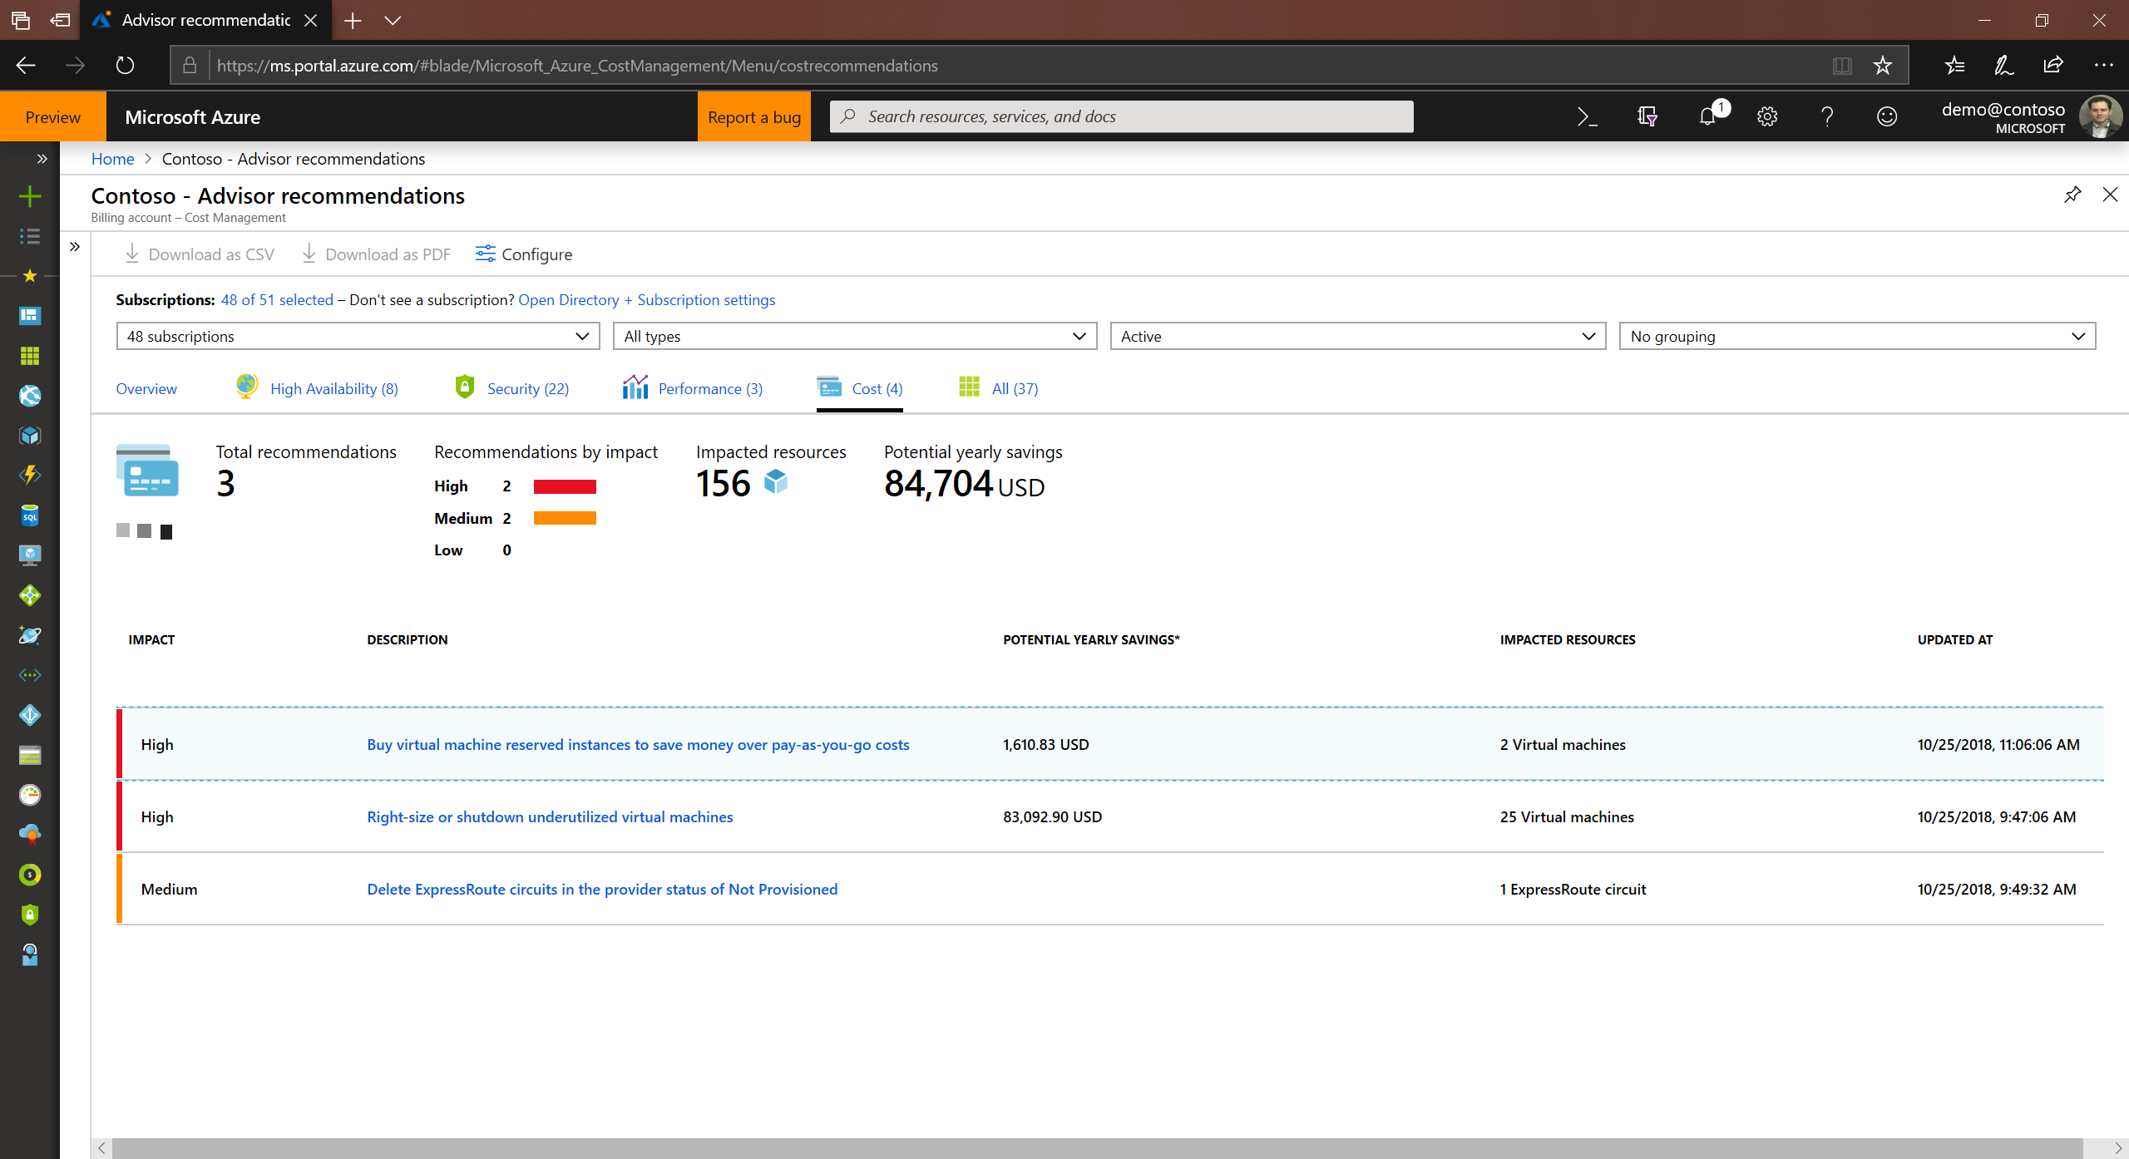
Optimize cloud efficiency
Increase resource utilization with virtual machine right-sizing
Eliminate idle resources
Reserved Instances recommendations
Take advantage of Azure Hybrid Benefits

Slide 11

Cost optimization is a key to cloud success
The workload will run fine in all three VM sizes
Which will a developer naturally choose?
Which will deliver more success to the business?
Which one will make managers and finance want more things in the cloud?
How do you know when there are opportunities to optimize?
VM1
VM2
VM3
Workload
Workload
Workload

Slide 12
ACM Integration
Integration with Azure
Management Groups
Tags
Action Groups
Integrated in the Azure Portal
Always on by default, no setup needed
Data hygiene for tags and policies
Optimize through Azure Advisor
Notifications through action groups
RBAC and management groups ensures better access controls
RBAC
Advisor
ACM
ARM
Policy

Slide 13
Demo

Slide 14

Doing some kind of cost management monitoring is important

Slide 15

Azure Policy

Slide 16

Traditional approach
Block Dev/Ops from directly accessing the cloud (portal/api/cli) to attain control
Developers
Cloud Custodian /
Engineers responsible for Cloud environment
Operations

Slide 17
Cloud-native governance
Removing barriers to compliance and enabling velocity
Developers
Cloud Custodian Team
Built-in controls through policy instead of workflow
Operations

Slide 18
Azure Policy
Turn on built-in policies or build custom ones for all resource types
Apply policies to a Management Group with control across your entire organization
Real time remediation
Real-time policy evaluation and enforcement
Apply multiple policies and & aggregate policy states with policy initiative
Remediation on existing resources (NEW)
Periodic & on-demand compliance evaluation
Exclusion Scope
VM In-Guest Policy (NEW)
Enforcement & Compliance
Apply policies at scale
Remediation

Slide 19




How does it work?
ARM – Centralized Control Plane
Azure Policy
User
Resource
Config
Request
Code

Slide 20


How does it work?
ARM – Centralized Control Plane
Azure Policy
User
Resource
Config
Request
Cloud Resource
Code

Slide 21

How does it work?
ARM – Centralized Control Plane
Azure Policy
User
Cloud Resource
Cloud Resource
Code
Cloud Resource

Slide 22
92 of the top 100 Azure Customers use policy ASOS “..we’re now confident that all of our IaaS is hardened to our very own standards” “..continuously helping us to reduce our attack surface in our DevTest environments” Ian Margetts, Platform Lead (ALM) Leslie Lintott, Lead Platform Engineer BP “..allowed BP to obtain a better security, compliance and audit profile” “..found policies to be a game changer simply because they provide control in areas which protect compute, network, storage and various other Azure services” John Maio, Chief Architect

Slide 23
Demo

Slide 24
Define operating policies such as
Naming Conventions
Deployment Locations
Deployment Types

Slide 25


Slide 26

Blueprints

Slide 27





How Blueprints work
1
Contoso Blueprint
Cloud Engineer
Creates a Blueprint
Cloud Engineer
Policies
3
Apply Blueprint to Scope (Sub, RG, MG)
2
Adds artifacts (azure resources) to be used
ARM Templates
RBAC
Scripts\Functions\
Runbooks
Deployed foundational artifact

Slide 28
Demo

Slide 29
Build a framework

Slide 30

Azure Automation

Slide 31
Azure Automation
Finance/Business
Smart use of Automation allows business to be more flexible to demand
Security/Risk Mgmt.
Provide consistent deployment of needed tools and resources for security management (agents, etc)
Technology Pro
Allow Technology Pros to create libraries of re-usable code to manage their environments

Slide 32
Automate where you can

Slide 33
Key Take Aways
Doing some kind of cost management monitoring is important
Define operating policies such as
Naming Conventions
Deployment Locations
Deployment Types
Build that framework
Automate where possible
Evaluate the tools at your disposal

Slide 34

https://aka.ms/sarahfeedback
Thank you | Q&A
@TechieLass

Slide 35
Resources
Blueprint docs: http://aka.ms/whatareblueprints
Policy Repository: https://github.com/Azure/azure-policy/
Azure Cloud Adoption Framework – https://aka.ms/caf

